Slide 1
Use of The Part 1 App for Item Independence
Questions or issues can be sent to David Schreurs at schreurd@uwm.edu

Slide 2
Overview
Part 1 (This App):
Runs Differential Item Functioning (DIF) through various methods to help establish good questions which will later be used as anchors between the assessments
Part 2 (Different App):
Based on the anchor items selected from Part 1 and a qualitative analysis of the items, this app will run anchored IRT.

Slide 3
Notes Before Running the App
Installation of BILOG-MG is required if the use of its algorithm is desired. If BILOG-MG installation was completed with the default options no further action should be required to use this feature. If BILOG-MG is not saved in the default location, you will have the option to specify the folder which contains the following three required files: blm1.exe, blm2.exe, and blm3.exe. Without BILOG-MG, the app can still be used with R’s “ltm” engine.
BILOG functionality is possible because R writes the necessary BILOG code files and then runs that code in the background. This means that running multiple instances of the app simultaneously may result in file conflicts leading to unexpected errors.

Slide 4
DIF Methods Used
Mantel-Haenszel
M-H searches for DIF through the construction of a 2 (subgroup 1/subgroup 2) x 2 (correct response/incorrect response) table for each proficiency level of student. Can only detect uniform DIF.
Logistic Regression
While less sensitive to the detection of uniform DIF, Logistic Regression is capable of detecting, and differentiating, between uniform and non-uniform DIF. This method models each of the subgroups independently and then searches for a significant main effect (indicating uniform DIF) as well as a significant interaction (indicating non-uniform DIF).
Lord's chi-squared (a.k.a Lord’s Wald test)
This test requires the construction of independent IRT models for each of the subgroups and then searches for a significant difference between the model parameters. This method detects uniform and non-uniform DIF but does not differentiate between them.
Purification
Each of the aforementioned methods is also conducted following purification. As all of these IRT methods require accurate scores or IRT models, purification iteratively removes items that were detected as showing DIF (and therefore were contaminating the test score or IRT model) and uses the new score/model to reconduct the DIF analysis. This is repeated until no further DIF is detected.

Slide 5
Table of Contents
Preparing Data
Running the App
Using the App
Interpreting Exported Results

Slide 6
Data
Before this app can be used the raw data needs to be prepared. This app allows you to import data saved as an excel document (.xlsx).
The excel document should include at least
1 column for each question wishing to be compared between two tests
All cells besides the heading must be a 0 (incorrect responses) or a 1 (correct responses). No other values or blanks are allowed and will result in an error message.
1 column for “grouping” indicating which assessment the student took
All cells besides the heading must be a 0 or a 1. This means the tests have to be compared in independent pairs (e.g. Test 1:Test 2, Test 1: Test 3, Test 2: Test 3)
1 row for each student who complete data is available for

Slide 7
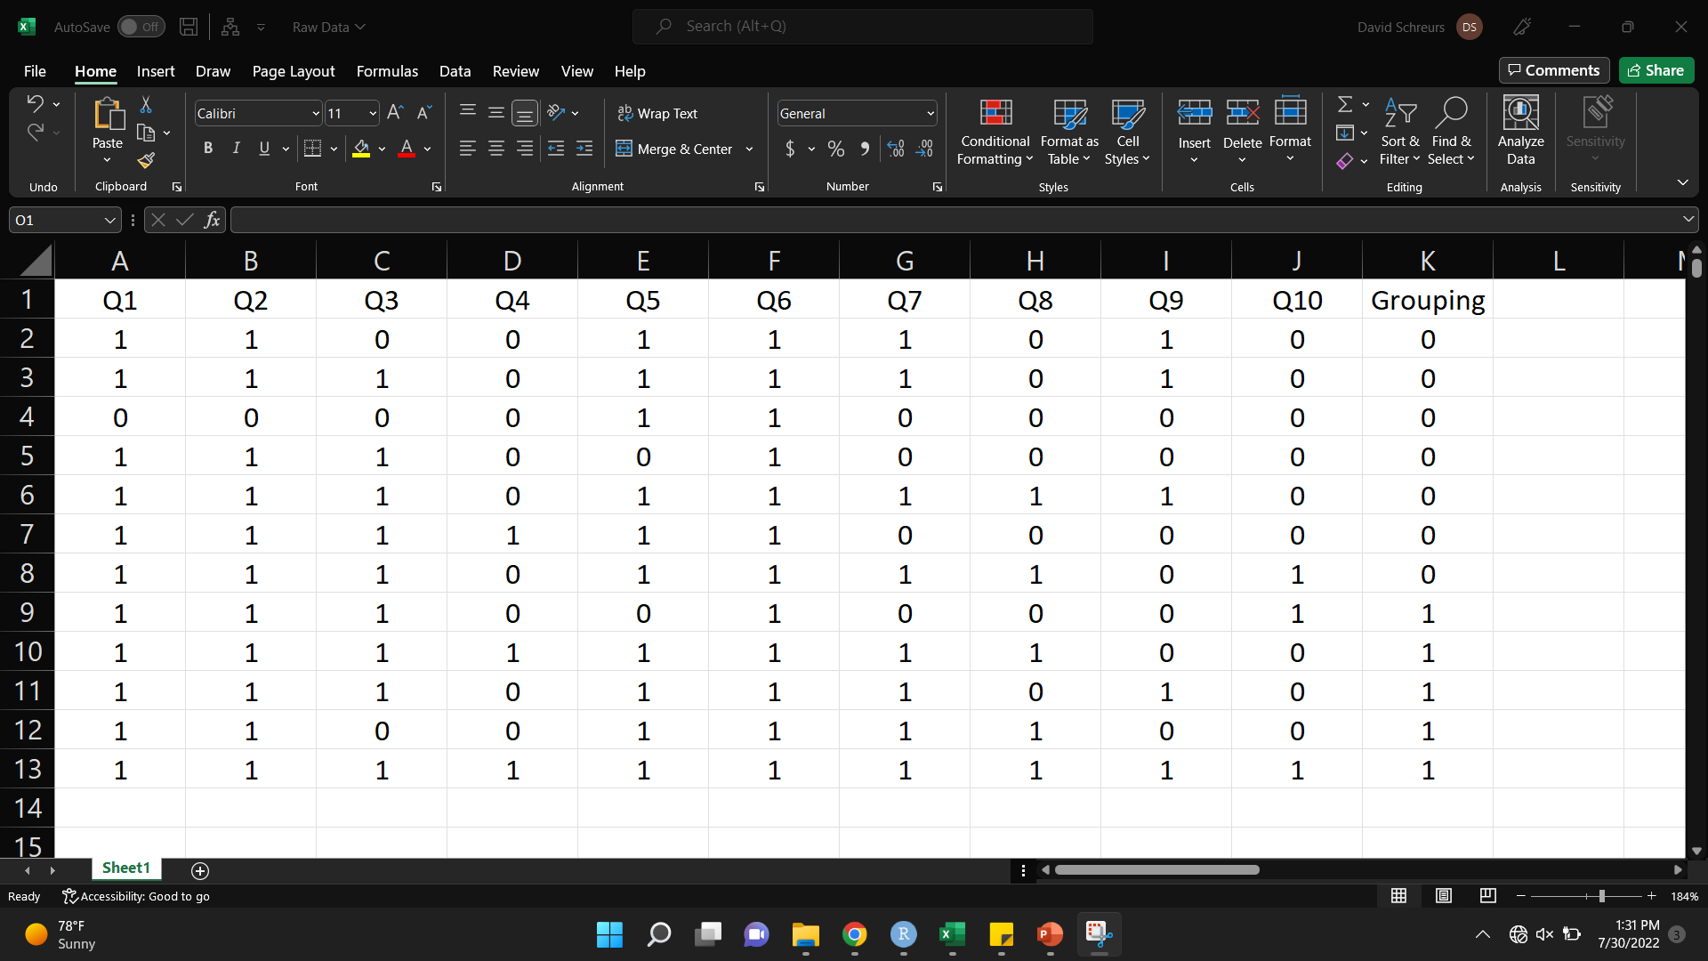
Example Data
Grouping (Which Test)
Questions
*Other columns can be present as long as they are selected to be omitted later on
Student Data
0: Incorrect
1: Correct

Slide 8
Running the App
Prior to opening the app, if this is the first time running the app on this computer, install the necessary packages by running these lines of code in the R console
install.packages(shiny)
install.packages(DT)
install.packages(shinyjs)
install.packages(ggplot2)
install.packages(readxl)
install.packages(irtoys)
install.packages(openxlsx)
install.packages(difR)
install.packages(subscore)
install.packages(shinydisconnect)
install.packages(irt)
install.packages(dplyr)
install.packages(shinyFiles)

Slide 9
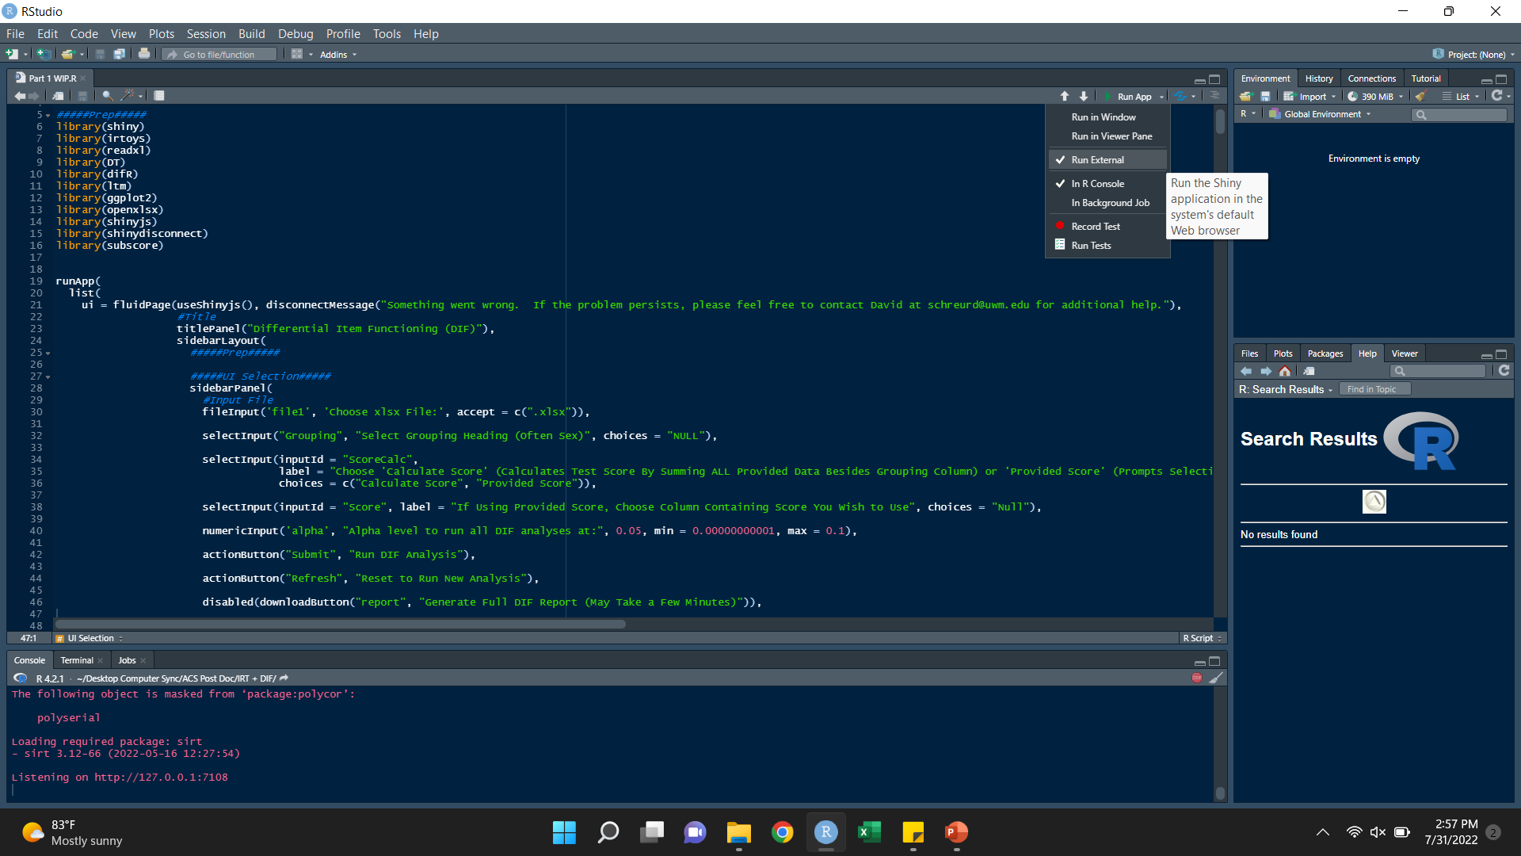
Running the App
Open the file in R Studio
In the upper right ensure “Run External” is checked as shown here
Then click “Run App”

Slide 10
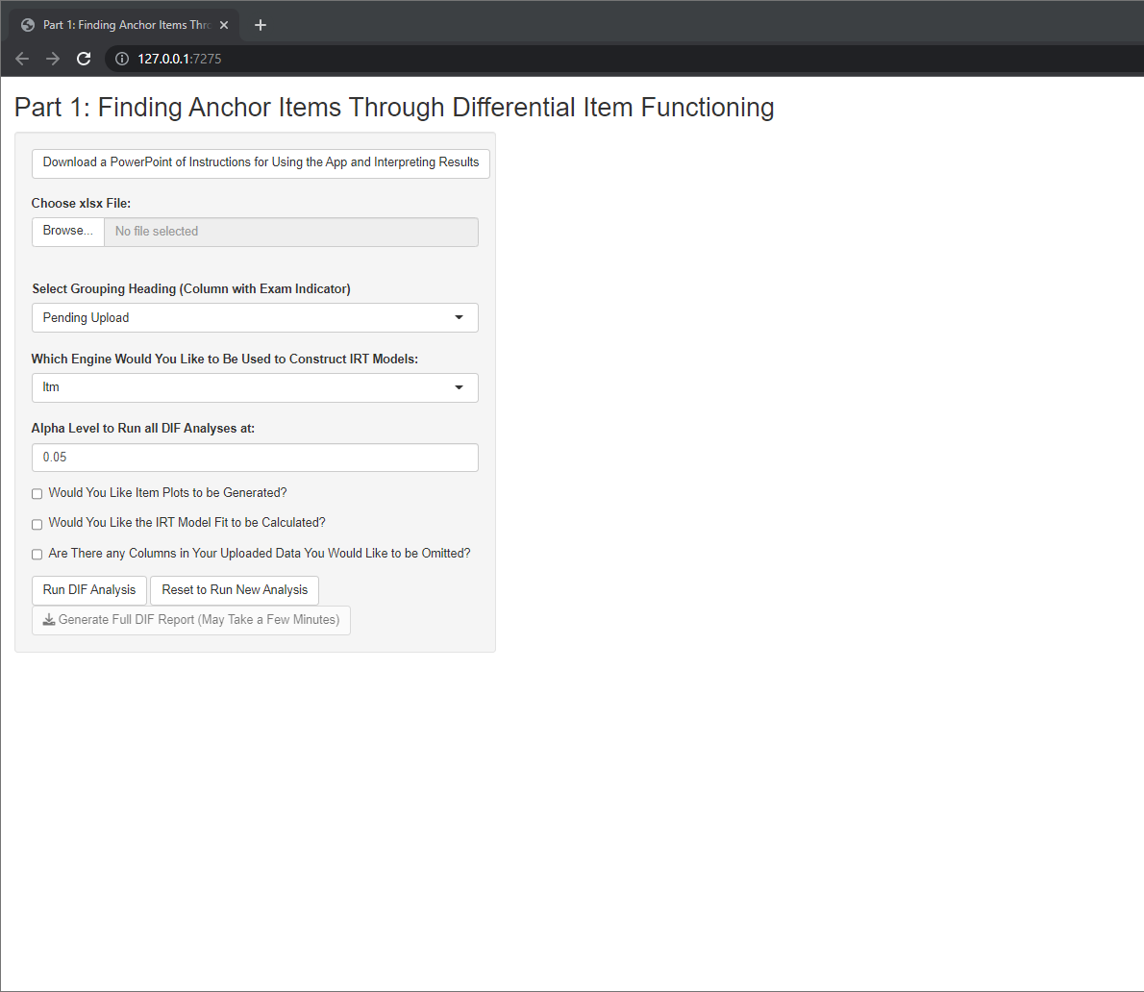
Using the App
Step 0: This button will allow you to download this PowerPoint document should you ever lose this copy or require instructions for future versions.

Slide 11
Using the App
Step 1: Click “Browse” which will prompt you to select the excel file you prepared during the previous slides

Slide 12
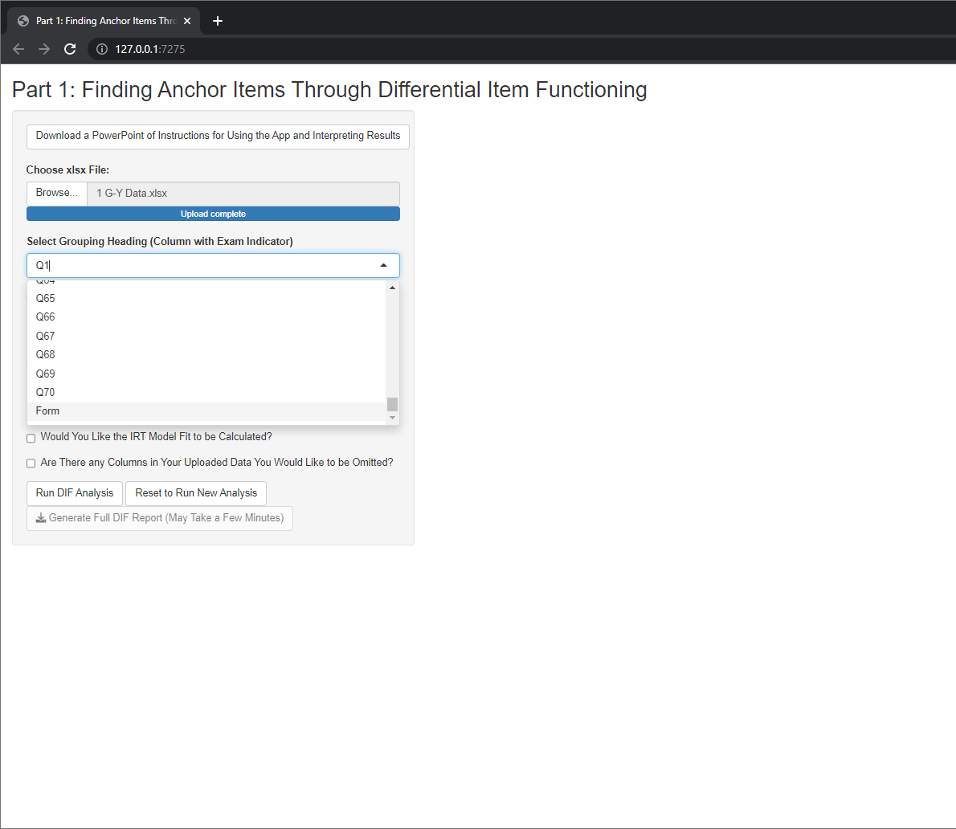
Using the App
Step 2: This dropdown menu will now be updated to provide the headings from the excel document which was uploaded. Select the heading corresponding to the column of data specifying the test the data was from. In this case, I named this column “Form”

Slide 13
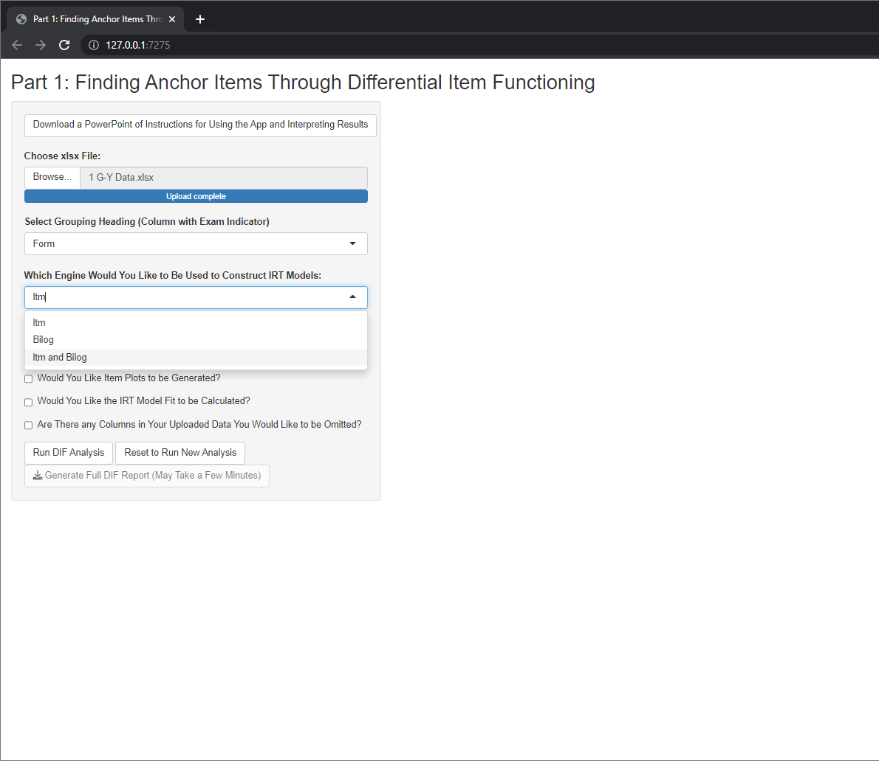
Using the App
Step 3: This dropdown allows you to specify which engine you would like to use for generating IRT parameters and fits. ltm is a package native to R which uses an empirical bayes algorithm, Bilog requires the installation of Bilog-MG which uses a maximum likelihood algorithm. If “ltm and Bilog” is selected, each engine will be used independently with the results from each being exported.

Slide 14
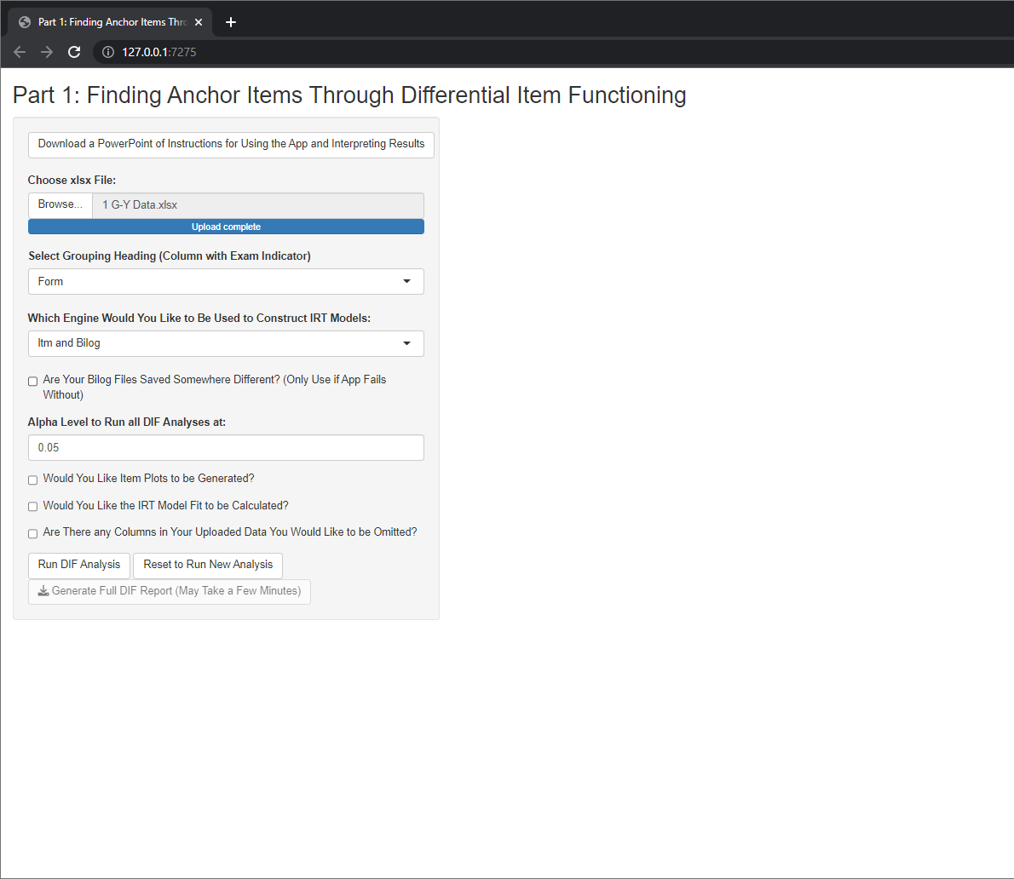
Using the App
Skip this step if you have the default Bilog installation
Step 4A: If Bilog is to be used, R needs access to the Bilog installation. By default, R will look in Bilogs default installation location (C:/Program Files/BILOGMG). If the files are saved elsewhere, check this box. If you are not sure, you can run the analysis with this unchecked and if R cannot find the needed files it will stop and tell you.

Slide 15
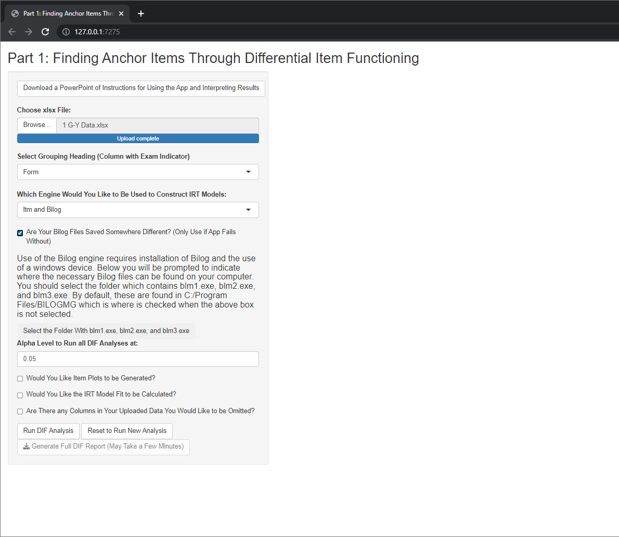
Using the App
Skip this step if you have the default Bilog installation
Step 4B: If your Bilog installation is saved elsewhere, a new button will appear where you can specify which folder contains the needed files.

Slide 16
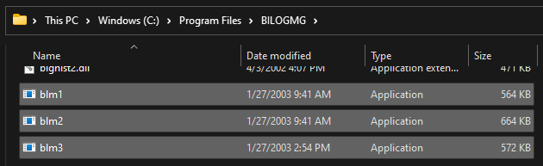
Using the App
Skip this step if you have the default Bilog installation
Step 4C: If your Bilog installation is saved elsewhere, go to your file explorer and find the path to the three needed files: blm1.exe, blm2.exe, and blm3.exe. Here you can see my installation is in the default location (C:/Program Files/BILOGMG).

Slide 17
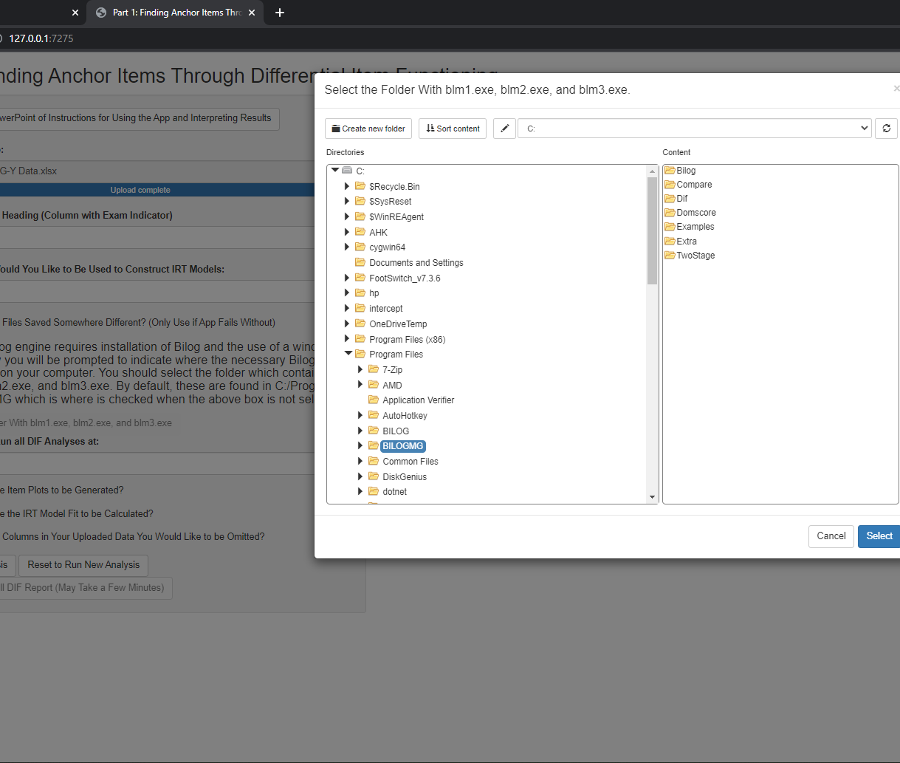
Using the App
Skip this step if you have the default Bilog installation
Step 4D: After you know where the needed files are located, return to R. After clicking the button to select the needed folder, a popup window will appear where you should select the folder where the files can be found.

Slide 18

Using the App
Step 5: Here you can input the alpha level you would like all analyses to be run at. This is set to 0.05 by default but with this many different analyses and with purification occurring a lower alpha will likely be more appropriate.

Slide 19
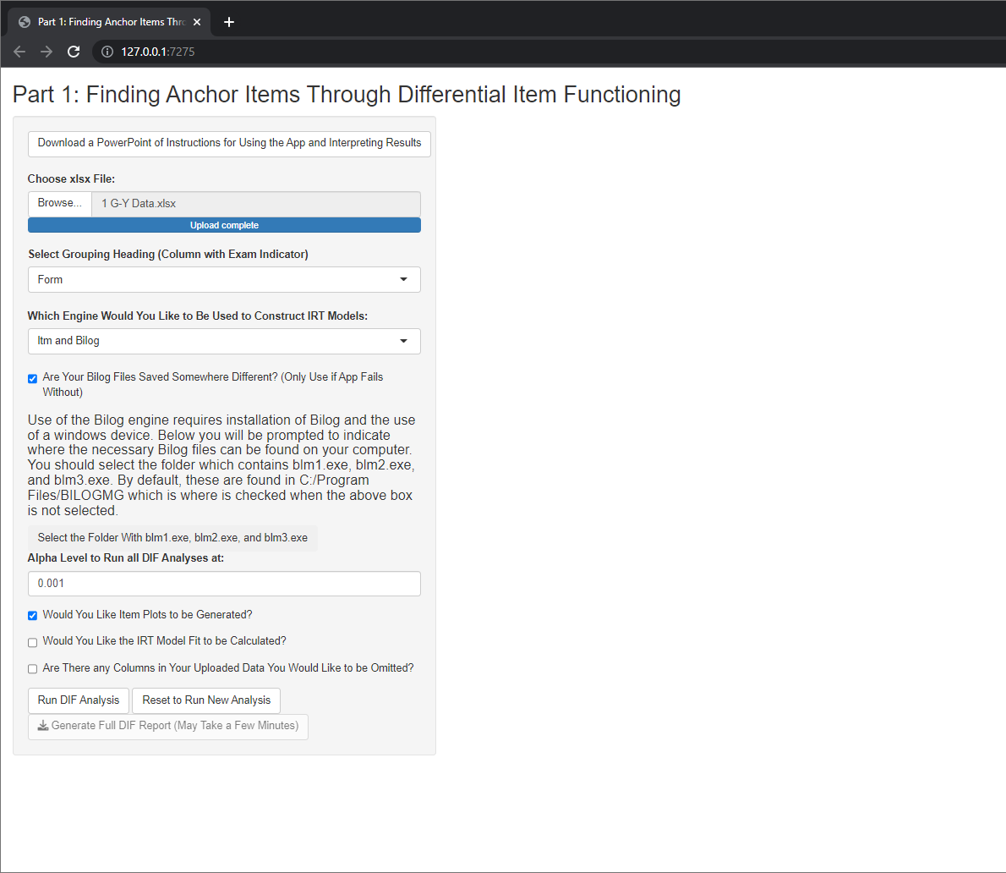
Using the App
Step 6: The next option should be checked if you would like item plots to be generated. These plots are a convenient method to visualize DIF from the perspective of CTT. However, selecting this option means the exporting of the data will take longer.

Slide 20

Using the App
Step 7: The next option should be checked if you would like the fit statistics to be calculated for the IRT models. These will be calculated for whichever engine(s) you previously selected in step 3. Once again, selecting this option means the exporting of the data will take considerably longer.

Slide 21
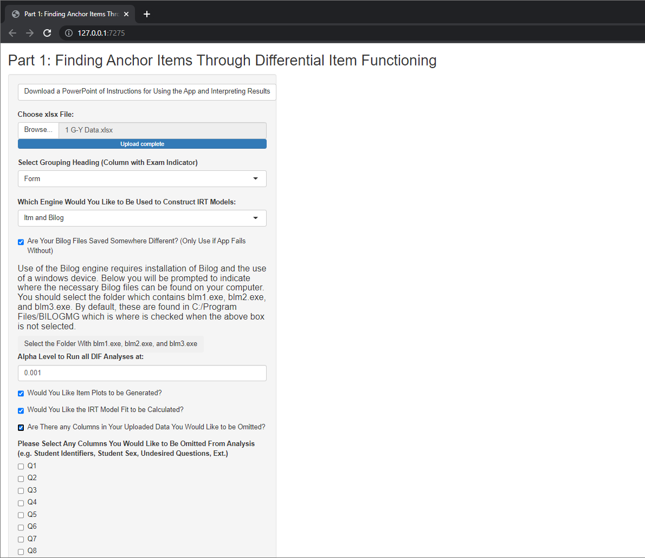
Using the App
Step 8A: This final option should be selected if your dataset includes any columns besides the relevant question-level data and the grouping column used to specify the exam (e.g. student identifiers, student sex, undesired questions, ext).

Slide 22
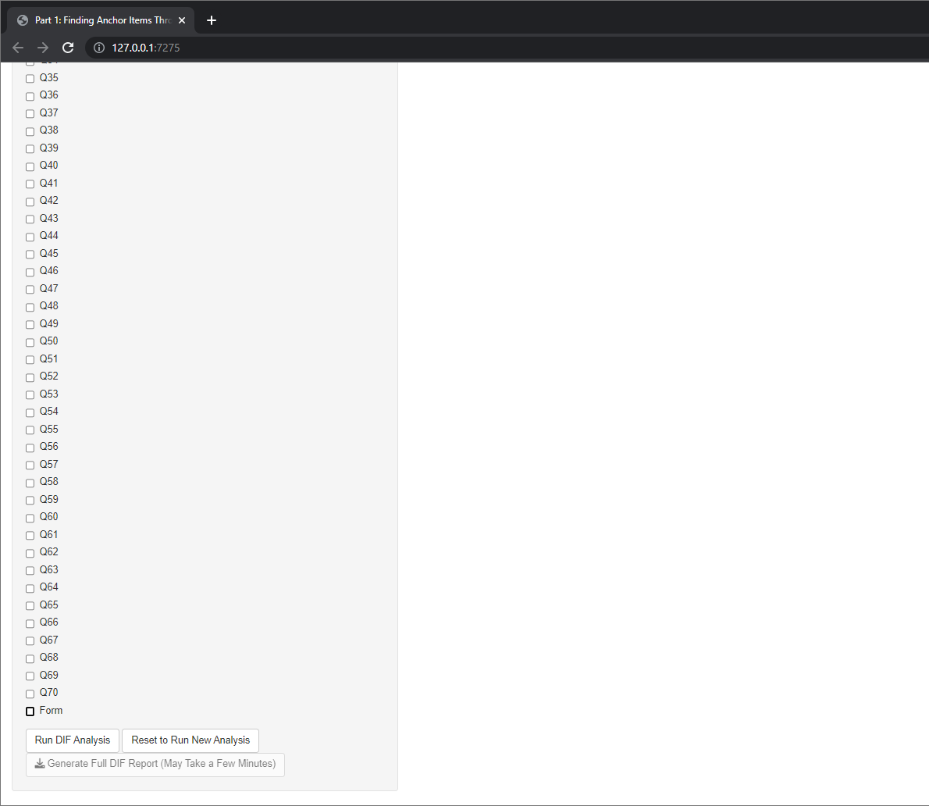
Using the App
Step 8B: If you indicated there are columns of data to be omitted, this new selection will pop-up with all of the column headings of your document. Select all columns that do not include the relevant data.
Side note: Your grouping column can be selected or left unselected

Slide 23
Using the App
Step 9: Click “Run DIF Analysis” when you have selected all relevant options.

Slide 24
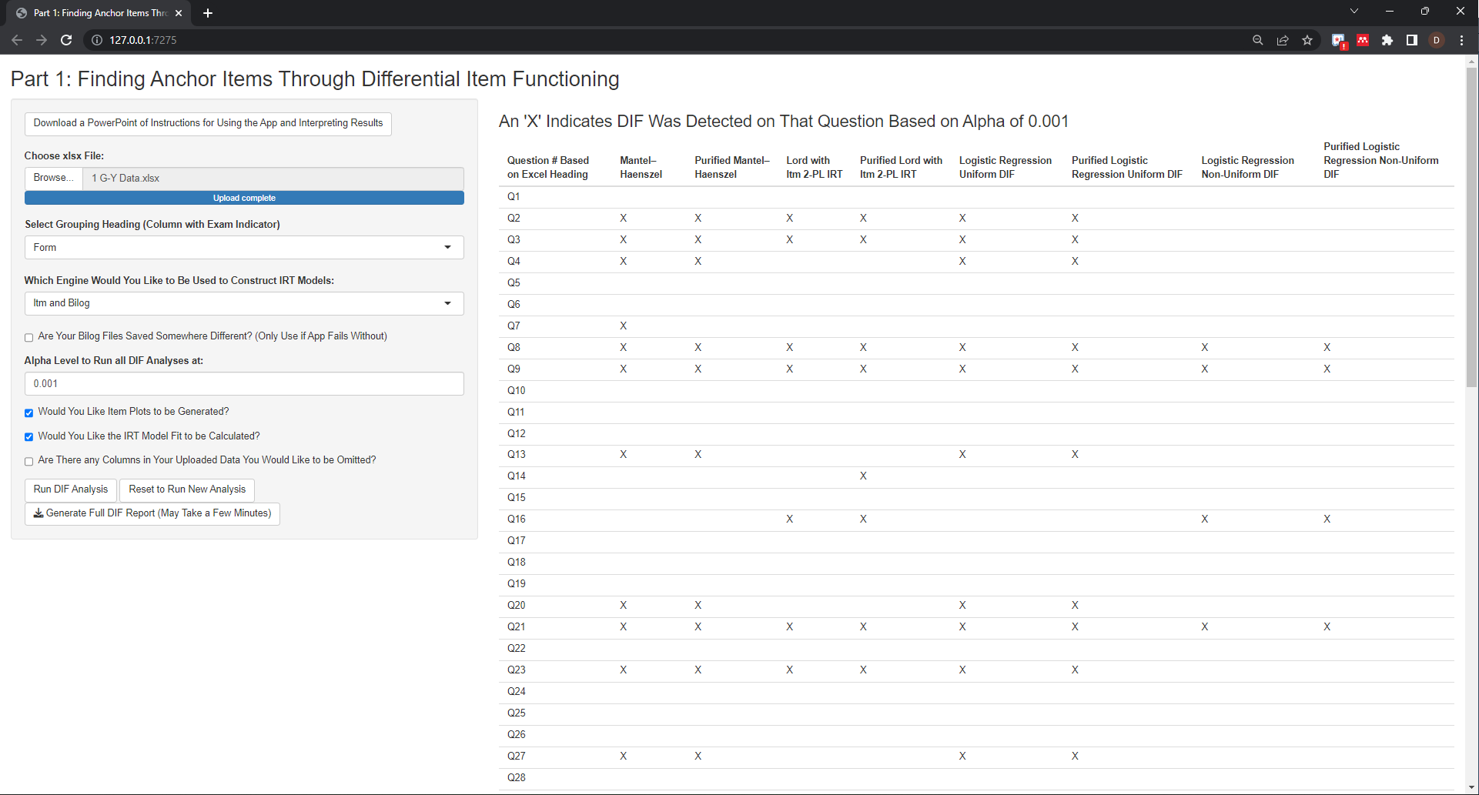
App Preliminary Results
The right of the page will show an “X” anywhere DIF was detected using the significance value provided

Slide 25
App Full Results
To get quantitative values, click “Generate Full DIF Report (May Take a Few Minutes)”. As indicated, this will take a few minutes depending on your previous checkbox selection. This will export the preview shown on the page, the quantitative values relative to each analysis, the IRT parameters from each model, item plots of the data (depending on selection), and the IRT model fits (depending on selection).

Slide 26
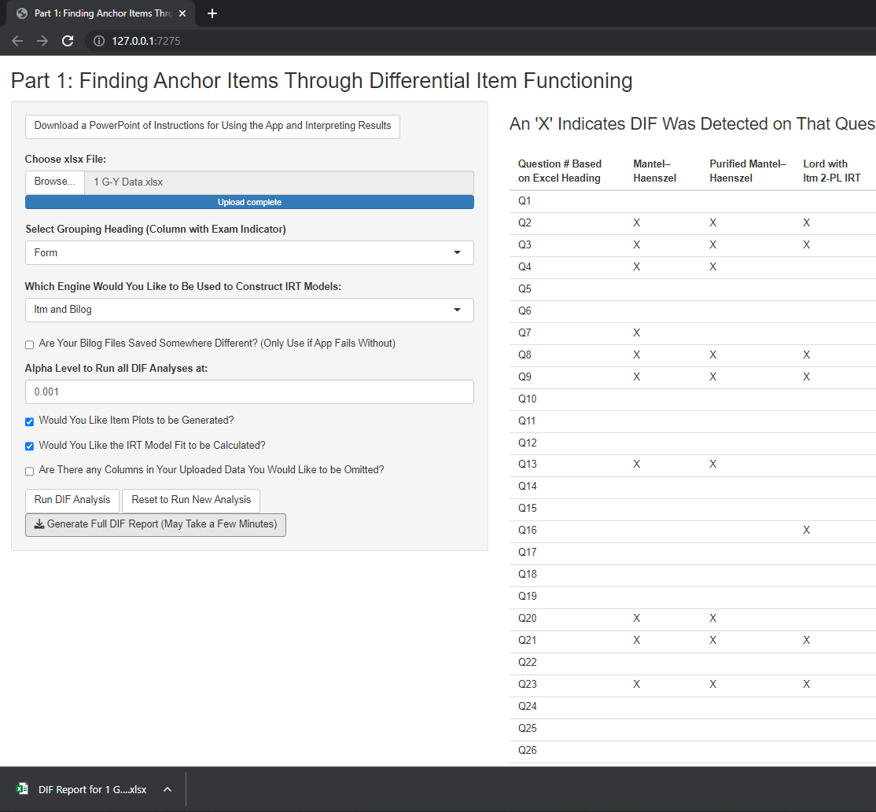
App Full Results
After the report is generated, a file will be downloaded. In chrome, this will appear on the bottom of the screen as well as in the computers “Downloads” folder. The file is named “DIF Report for…” prior to the name of the file selected for analysis. Since my data file was named “1 G-Y Data.xlsx”, my downloaded file is named “DIF Report for 1 G-Y Data.xlsx”

Slide 27
App Reset
To run a different analysis, you can either exit and relaunch the app or press the “Reset to Run New Analysis” button.

Slide 28
Interpreting Exported Results
The downloaded document should be an excel document which contains several tabs of data.
File Summary
Results Preview
Numeric Results
IRT Parameters
Item Plots (*If Selected)
IRT Fit (*If Selected)

Slide 29
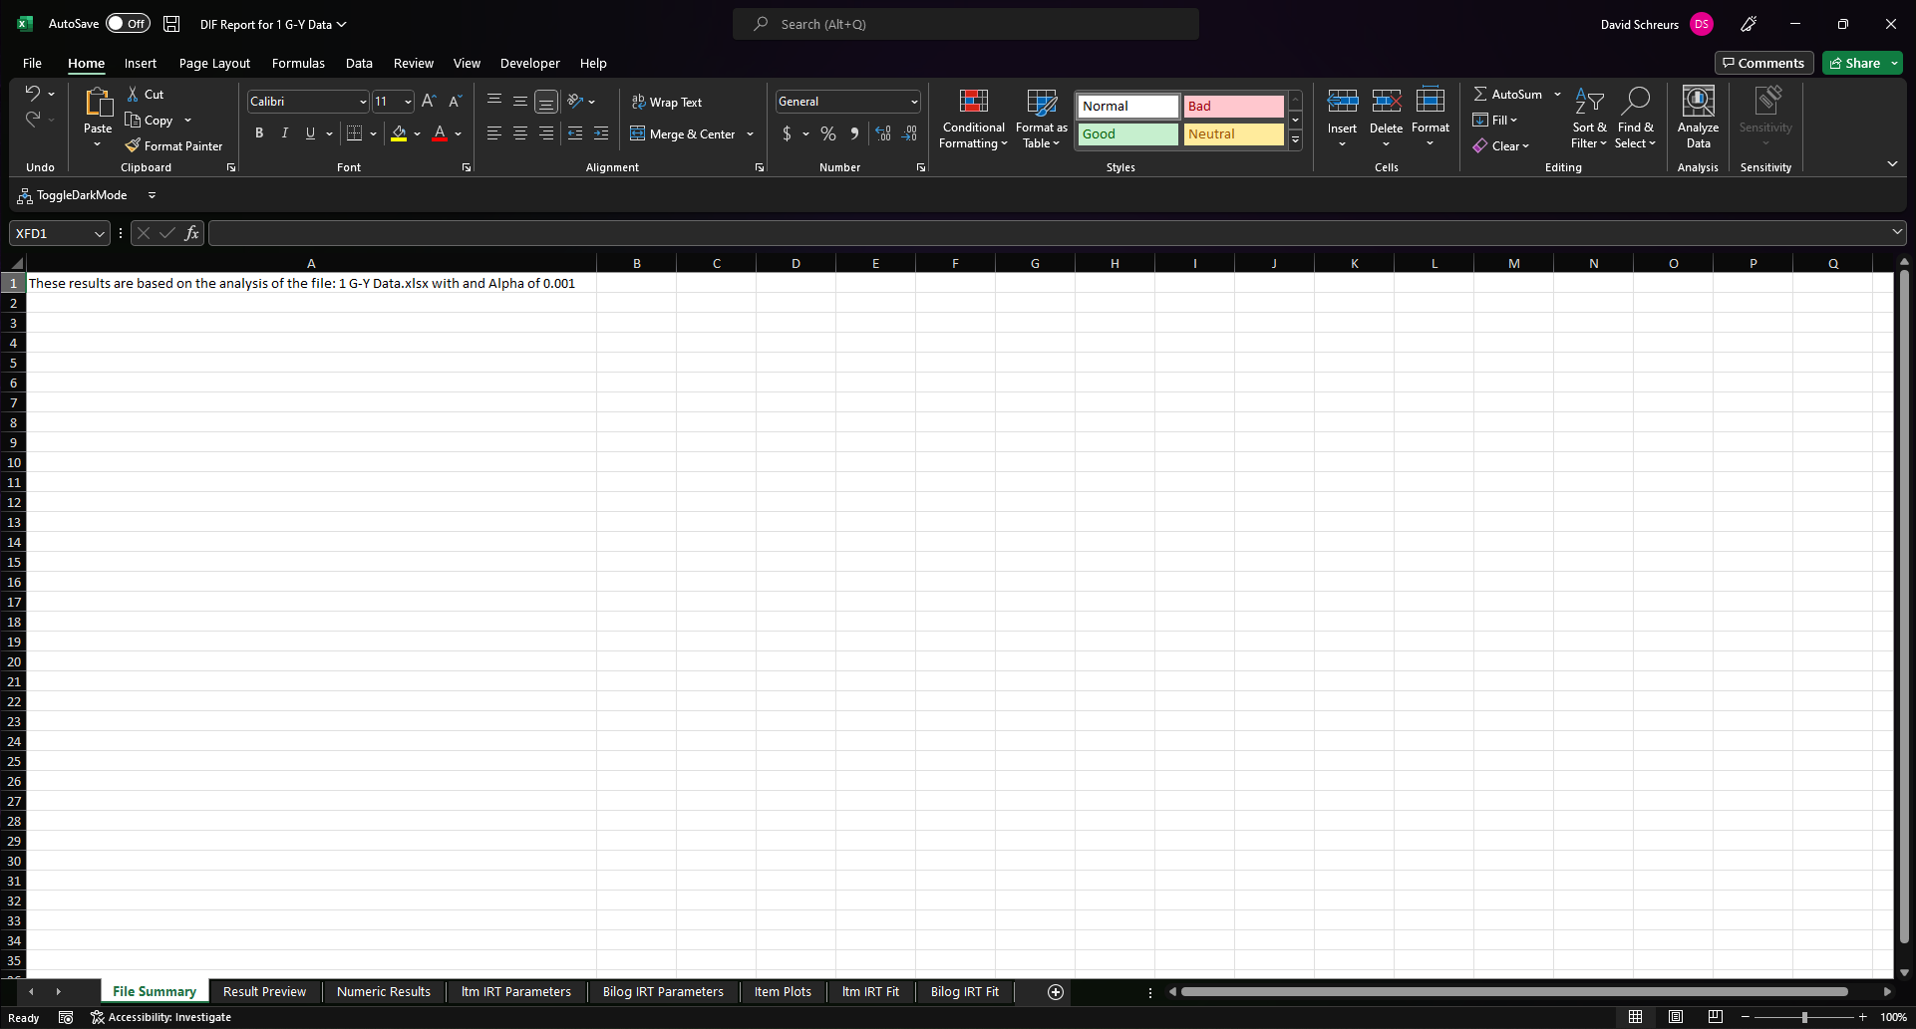
1. File Summary
A reminder of what data and what alpha value this analysis corresponds to.

Slide 30
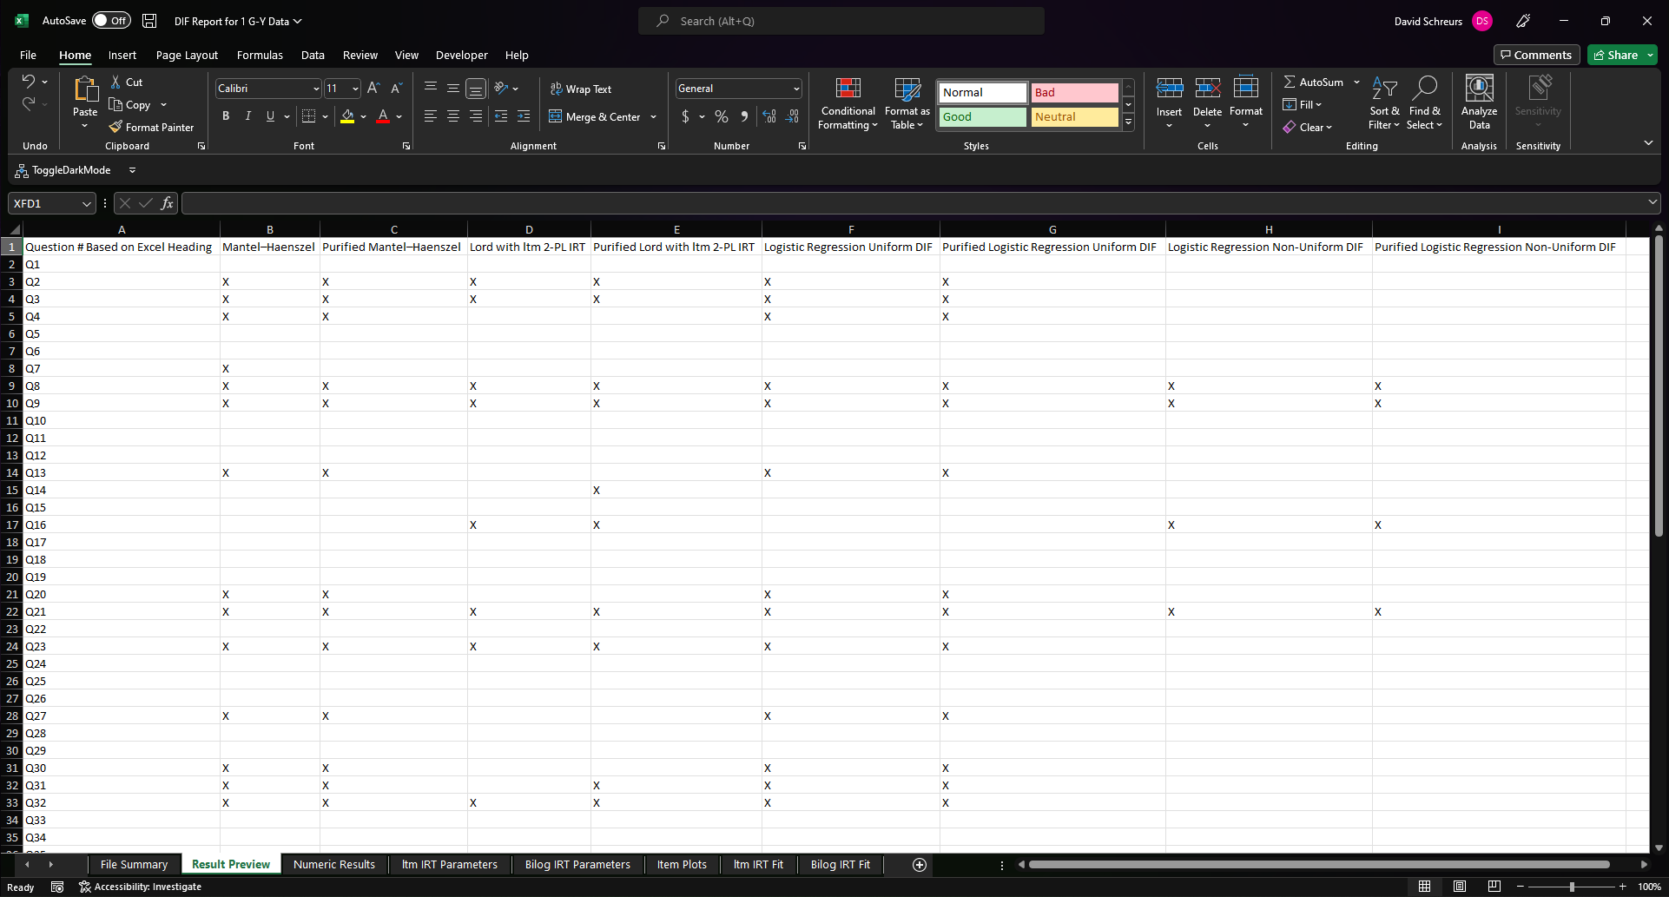
2. Results Preview
An export of the results preview shown within the app. Once again, an “X” indicates that DIF was detected for that question, through that method, at the specified alpha level.

Slide 31
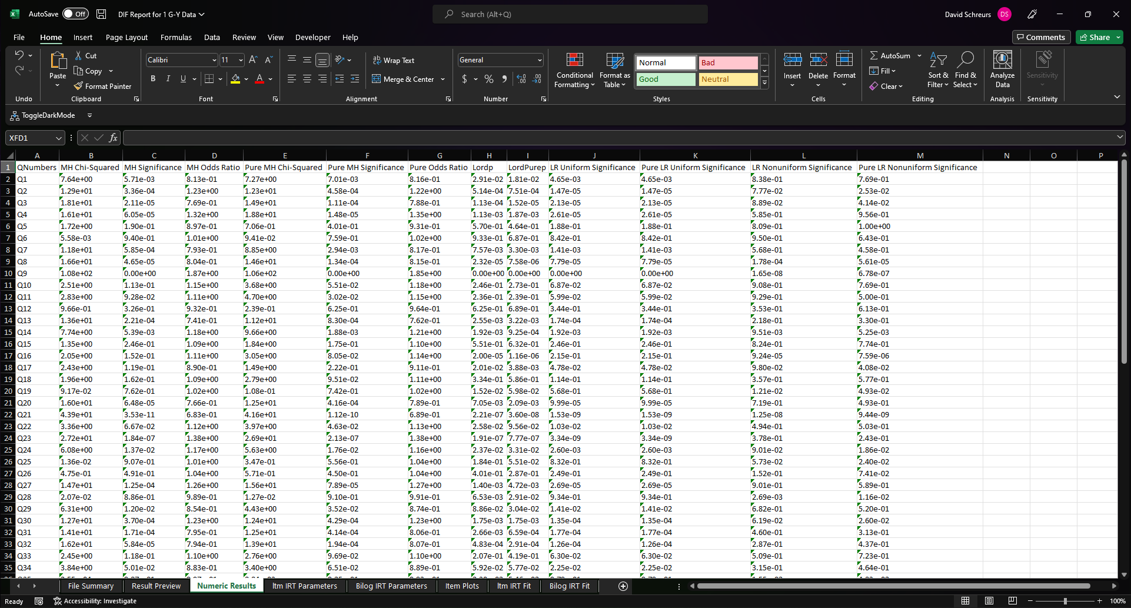
3. Numeric Results
Quantitative values important for each of the methods used. Each of these are described on the next slide in more detail.

Slide 32
3. Numeric Results
MH Chi-Squared
When using the Mantel-Haenszel (MH) method, this was the chi-squared value calculated which was used to determine DIF significance
MH Significance
When using the Mantel-Haenszel method, this was the significance value which was compared against the specified alpha level to determine DIF significance
MH Odds Ratio
When using the Mantel-Haenszel method, this odds ratio shows the effect size and favor of the DIF. Values great than “1” are interpreted as the students taking exam “1” performed __ times better than students taking exam “0”. Values less than “1” are interpreted as the students taking exam “0” performed 1/__ times better than students taking exam “1”.
Pure MH Chi-Squared
When using the Mantel-Haenszel (MH) method and conducting purification, this was the chi-squared value calculated which was used to determine DIF significance
Pure MH Significance
When using the Mantel-Haenszel method and conducting purification, this was the significance value which was compared against the specified alpha level to determine DIF significance
Pure Odds Ratio
When using the Mantel-Haenszel method and conducting purification, this odds ratio shows the effect size and favor of the DIF. Values great than “1” are interpreted as the students taking exam “1” performed __ times better than students taking exam “0”. Values less than “1” are interpreted as the students taking exam “0” performed 1/__ times better than students taking exam “1”.

Slide 33
3. Numeric Results
Lordp
When using the Lord's chi-squared method, this was the significance value which was compared against the specified alpha level to determine DIF significance. Note: this method is always completed using parameters found through the ltm engine, Bilog functionality for this DIF method is not available in this app.
LordPurep
When using the Lord's chi-squared method and conducting purification, this was the significance value which was compared against the specified alpha level to determine DIF significance. Note: this method is always completed using parameters found through the ltm engine, Bilog functionality for this DIF method is not available in this app.
LR Uniform Significance
When using the Logistic Regression method and searching for uniform DIF, this was the significance value which was compared against the specified alpha level to determine DIF significance
Pure LR Uniform Significance
When using the Logistic Regression method, searching for uniform DIF, and conducting purification, this was the significance value which was compared against the specified alpha level to determine DIF significance
LR Nonuniform Significance
When using the Logistic Regression method and searching for non-uniform DIF, this was the significance value which was compared against the specified alpha level to determine DIF significance
Pure LR Nonuniform Significance
When using the Logistic Regression method, searching for non-uniform DIF, and conducting purification, this was the significance value which was compared against the specified alpha level to determine DIF significance

Slide 34
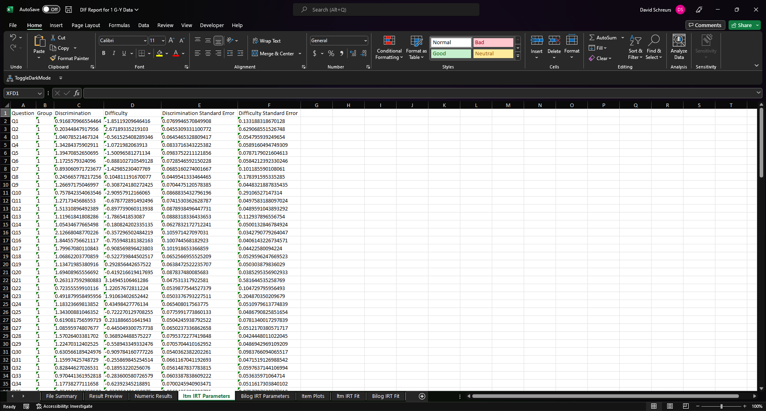
4. IRT Parameters
The IRT parameters for each question and each assessment. This is where you will pull the desired IRT parameters for anchoring in Part 2.
Which IRT engine you selected will determine which of these tabs (or both) will be present

Slide 35
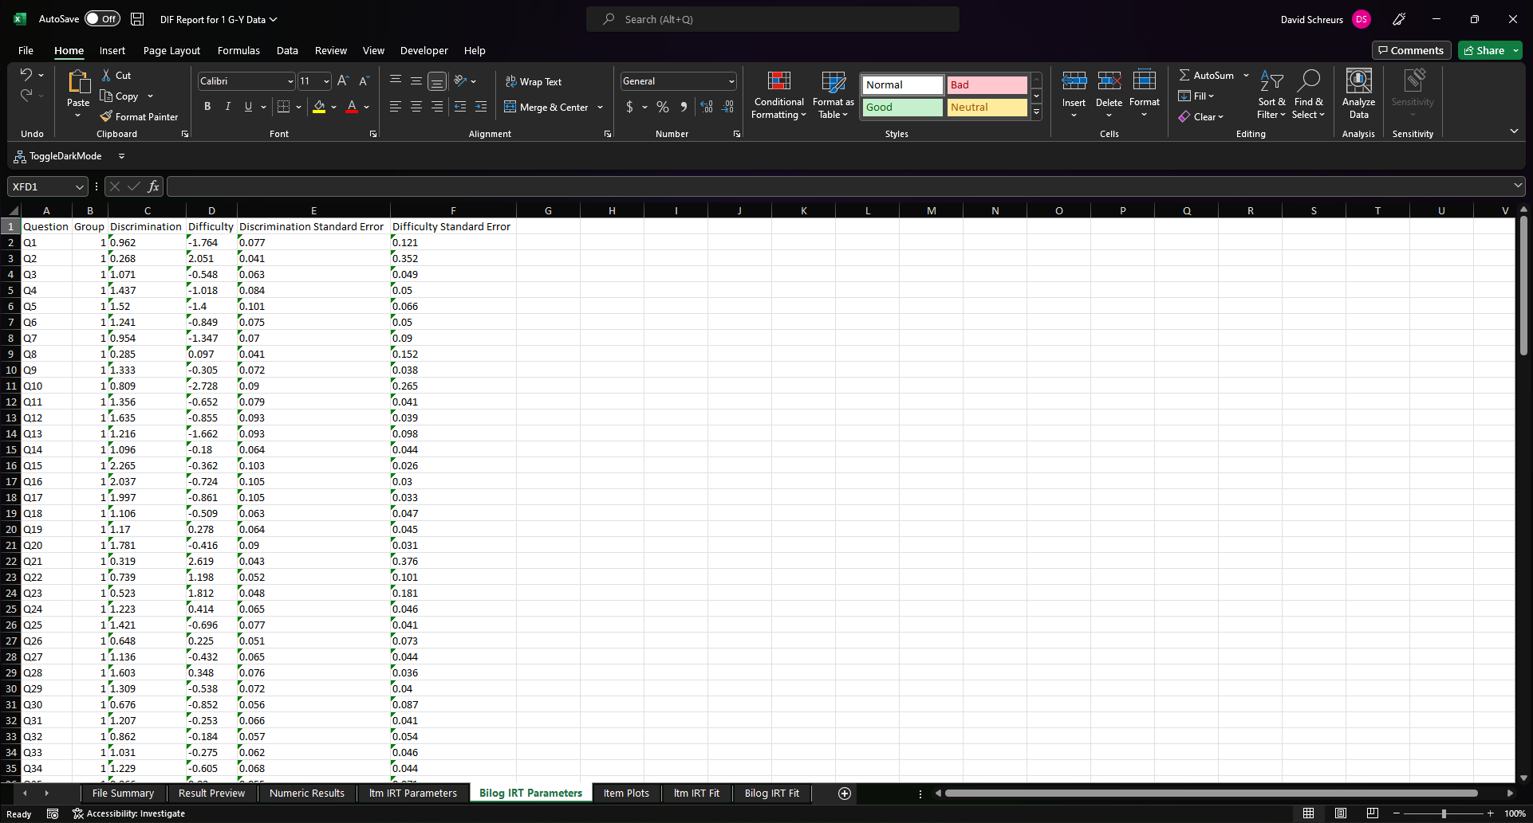
4. IRT Parameters
The IRT parameters for each question and each assessment. This is where you will pull the desired IRT parameters for anchoring in Part 2.
Which IRT engine you selected will determine which of these tabs (or both) will be present

Slide 36
4. IRT Parameters
Question
Question that the parameters correspond to
Group
These correspond to which assessment (0 or 1) that the parameters were generated from. Assessment 1 appears on top with assessment 0 on bottom.
Discrimination
The slope of the item characteristic curve
Difficulty
The ability level modeled to have a 50% chance of answering the question correctly
Discrimination Standard Error
The standard error corresponding to the discrimination IRT parameter
Difficulty Standard Error
The standard error corresponding to the difficulty IRT parameter

Slide 37
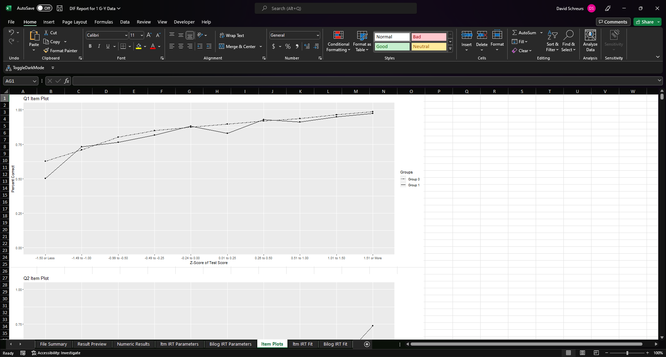
5. Item Plots (*If Selected)
Classical test theory method for visualizing DIF. The x-axis has binned z-scores of students test scores and the why has the percent of students within that bin who answered the question correctly. Overlap of lines suggest no DIF as seen in Q1.

Slide 38
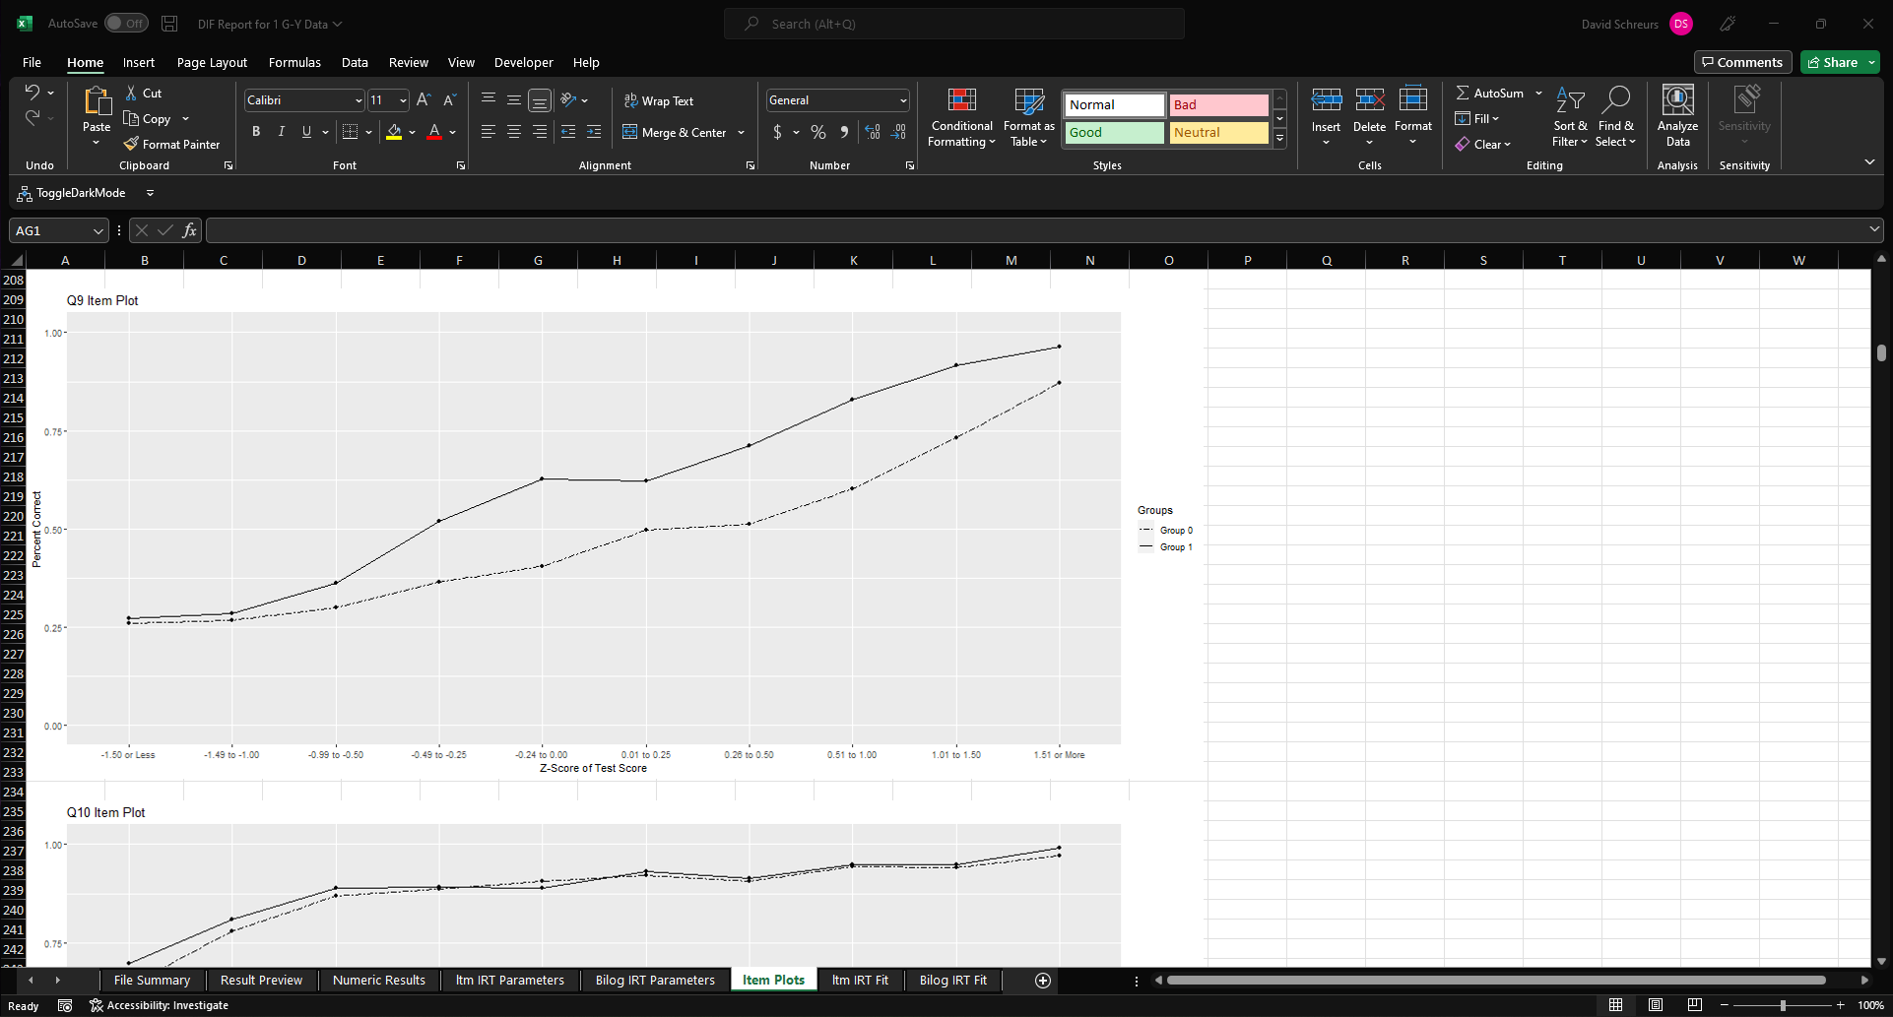
5. Item Plots (*If Selected)
Misalignment of lines suggests DIF like the uniform DIF (similar slopes but shifted up), favoring students who took assessment 1 (solid like above dotted line), shown in Q9.

Slide 39
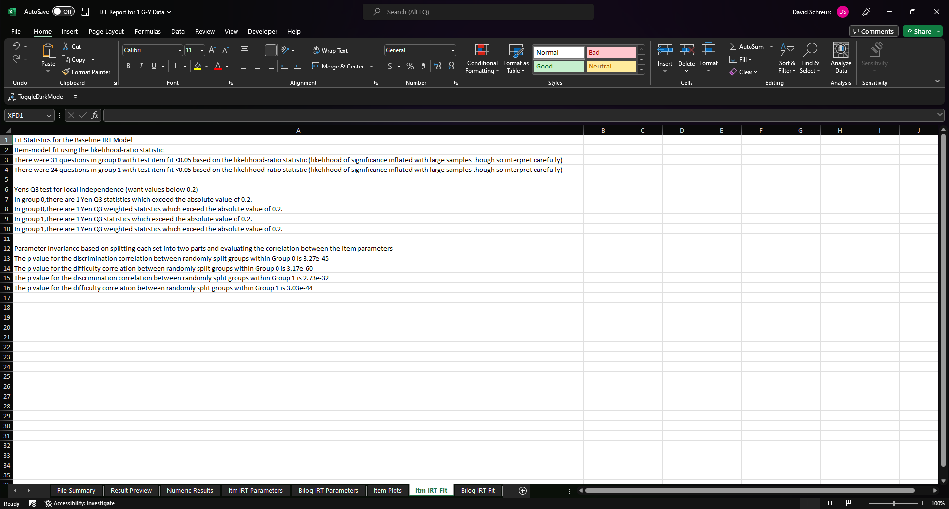
6. IRT Fit (*If Selected)
Several fit statistics for the IRT models used to generate the IRT parameters. These are explained further on the last slide.
Which IRT engine you selected will determine which of these tabs (or both) will be present

Slide 40
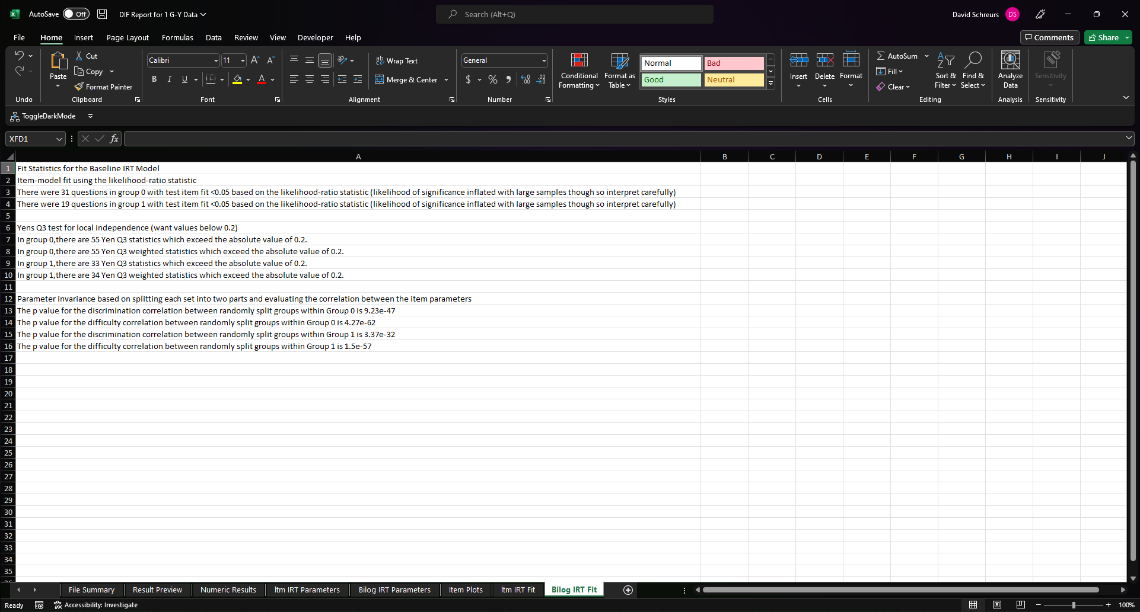
6. IRT Fit (*If Selected)
Several fit statistics for the IRT models used to generate the IRT parameters. These are explained further on the last slide.
Which IRT engine you selected will determine which of these tabs (or both) will be present

Slide 41
6. IRT Fit (*If Selected)
Item-model fit using the likelihood-ratio statistic
Divides examinees into groups of similar ability and compares the observed proportion of correct answers in each group with the expected proportion under the proposed model. This app uses the “likelihood-ratio statistic” for calculation. Significant items means the item does not fit however as specified in the document, the likelihood of finding significance is dramatically inflated at large sample sizes so interpret liberally.
Yens Q3 test for local independence (want values below 0.2)
IRT assumes local independence (i.e. conditional on the latent trait, item responses are unrelated). This method returns the number of pairs which may violate local independence.
Parameter invariance based on splitting each set into two parts and evaluating the correlation between the item parameters
Test the stability of the parameter estimates by randomly splitting each sample in half, conducting IRT on each of the split samples, and then analyzing the correlation between the two split samples. Higher correlation indicates better parameter stability.

